Slide 1
FINANCIAL ANALYSIS
(COSTCO & WALMART)

Slide 2
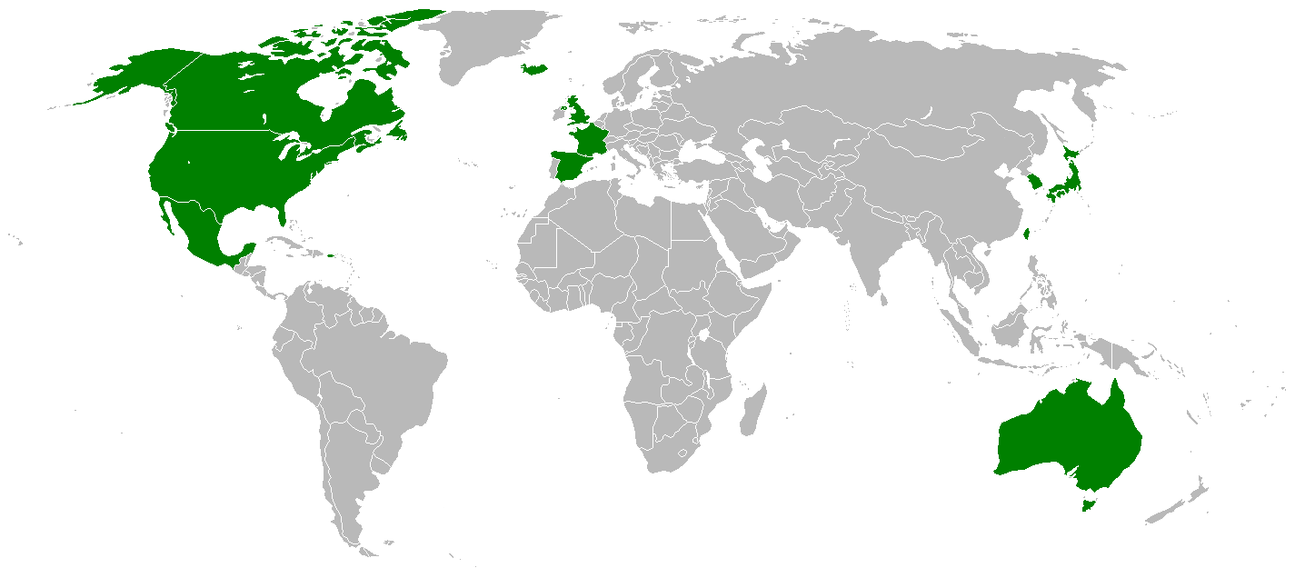
Intro
American Multi-national corporation
2nd largest discount store
Broad spectrum of products and services

Slide 3
Industry Analysis
S
W
TRENGTHS
EAKNESSES
Low cost retail industry is a big market with high net sales and market share. The major strengths of this industry are;
- Economies of scale
- Globalised business
- Huge target market
The profit margins in this industry are very low due to high competition and bulk sales. There is a threat from other retail giants as well as other speciality sellers.
O
T
PPORTUNITIES
HREATS
Being the retailors of low cost products, these companies could expand into developing countries with large populations like India or China.
Some possible threats to this industry
Is the growing competition and popularity for
Superior quality goods.

Slide 4
Porter’s five forces
INDUSTRY ANALYSIS
CONCLUSION
THREAT OF NEW ENTRENTS
BARGAINIG-POWER OF SUPPLIER
INCUMBENT RIVALRY
BARGAINING POWER OF BUYER
THREAT OF SUBSTITUTION
Highly competitive industry with price sensitive consumers as the bargaining power of consumers is very high.
Where as the bargaining power of supplier is low and the threat of substitution is also there because organic products and products of better quality are gaining popularity.
HIGH
MEDIUM
LOW
MEDIUM
HIGH

Slide 5
Costco’s Positioning
Discount Pricing
Consistent Pricing
Buying directly from suppliers
Selling items in bulk
Membership based
Customer loyalty
Fourth largest retailer globally
Second largest discount store in the world, after Walmart
Notes:
Selling most items in bulk which saves on cost, fast inventory turnover, selling a lot of items at once vs one at a time and higher sales.
Costco to rely less on the actual sales of items and more on deriving profit from membership and renewal fees. The number of Costco members grew to 94.3 million in 2018 from 90.3 million in 2017.
(Non-membership operating margins were only about 1% of the company's non-membership revenue.) The company’s differentiated business model has helped it control operational costs and sustain its profitability.

Slide 6









Walmart
Retailers with wide variety
Lots of inventories
Discounted pricing
Omni channel capabilities
Leading mass merchant in the US and internationally
11766 stores worldwide
Generates 4 times more retail sales than Costco
Efficiency?
Notes:
Two of the winners appear to be Walmart and Costco, which are up a market-beating 22% and 36%, respectively, on the year

Slide 7
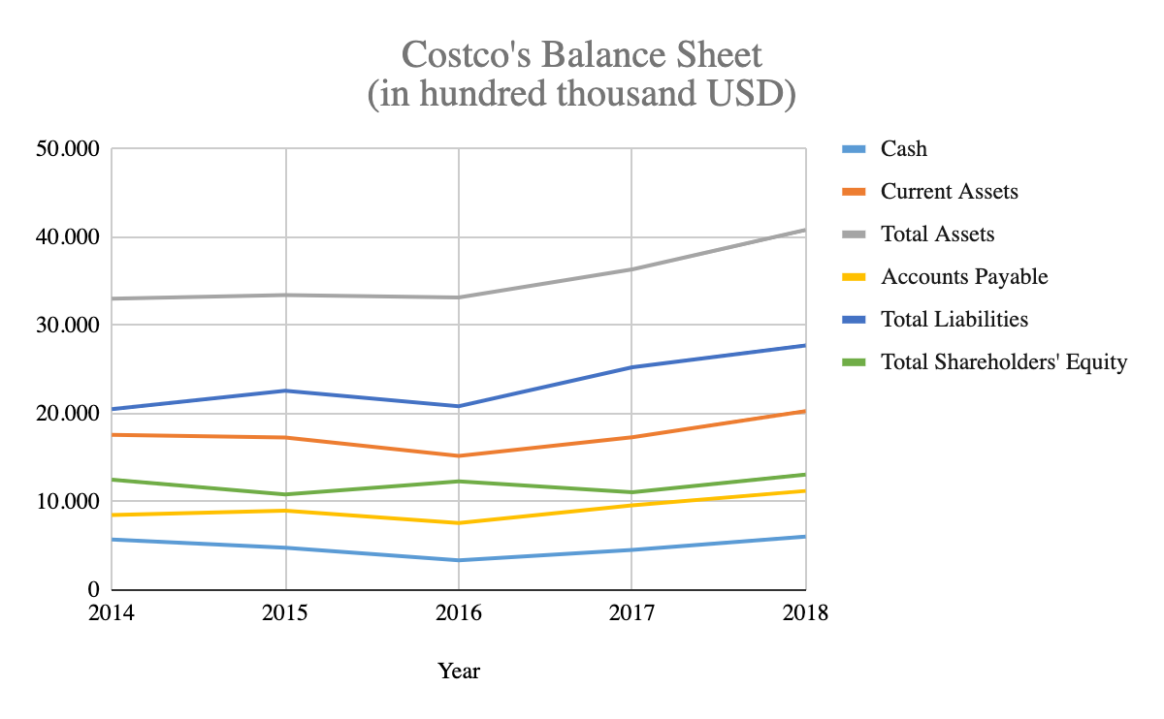
Balance

Slide 8
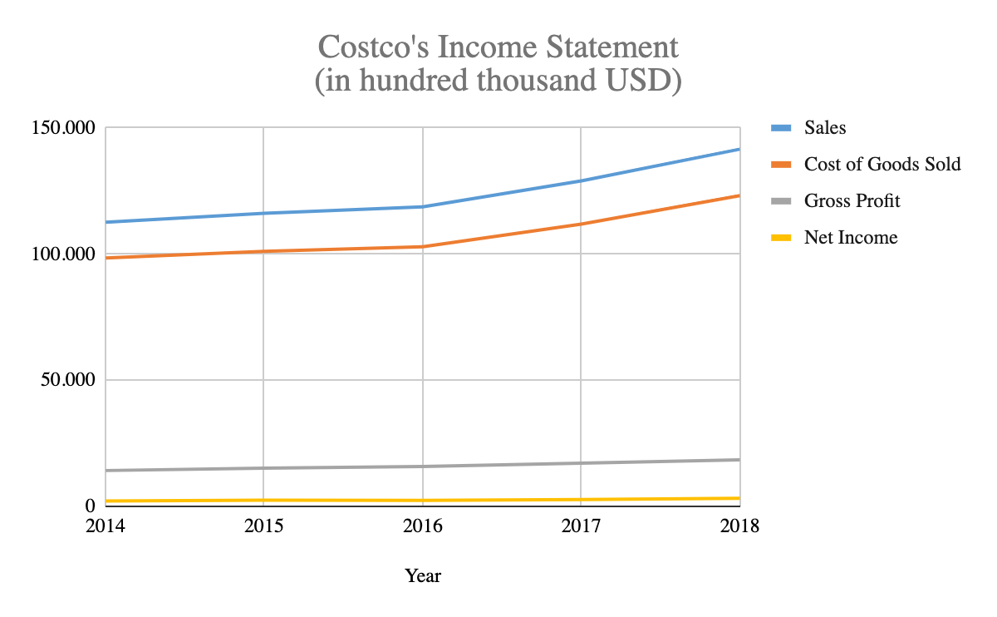
Income Statement

Slide 9



Ratios Analysis 1/3
 | 2018 | 2016 | 2014
ROA | 0.08 | 0.07 | -
Profit Margin | 0.02 | 0.02 | 0.02
Asset Turnover | 3.67 | 3.56 | -
ROE | 0.26 | 0.21 | 0.21
NOPM | 0.02 | 0.02 | 0.2
Gross Profit Margin | 0.13 | 0.13 | 0.13
 | 2018 | 2016 | 2014
ROA | 0.03 | 0.07 | 0.08
Profit Margin | 0.01 | 0.03 | 0.03
Asset Turnover | 2.43 | 2.44 | 2.38
ROE | 0.08 | 0.03 | 0.03
NOPM | 0.01 | 0.03 | 0.03
Gross Profit Margin | 0.25 | 0.26 | 0.26

Slide 10

Ratios Analysis 2/3
 | 2018 | 2016 | 2014
Accounts Receivable Turnover | 91.31 | 95.90 | -
Inventory turnover | 27.13 | 26.56 | -
Accounts Payable Turnover | 11.82 | 12.38 | -
PPE Turnover | 4.79 | 4.76 | -
 | 2018 | 2016 | 2014
Accounts Receivable Turnover | 86.48 | 84.80 | 72.19
Inventory turnover | 11.68 | 11.1 | 10.79
Accounts Payable Turnover | 8.27 | 9.04 | 9.63
PPE Turnover | 4.85 | 4.46 | 4.23

Slide 11


Ratios Analysis 3/3
 | 2018 | 2016 | 2014
Current Ratio | 1.02 | 0.98 | 1.22
Quick Ratio | 0.45 | 0.38 | 0.59
Cash Conversion Cycle | 4.04 | 6.03 | 3.59
RNOA | 0.22 | 0.20 | 0.21
 | 2018 | 2016 | 2014
Current Ratio | 0.80 | 0.86 | 0.97
Quick Ratio | 0.18 | 0.19 | 0.24
Cash Conversion Cycle | 1.81 | 8.14 | 12.14
RNOA | 0.04 | 0.08 | -
 | 2018 | 2016 | 2014
Total liabilities to equity | 2.19 | 1.87 | -
Financial Leverage | 3.19 | 2.97 | -
 | 2018 | 2016 | 2014
Total liabilities to equity | 1.68 | 1.46 | 1.49
Financial Leverage | 2.64 | 2.43 | 2.44

Slide 12
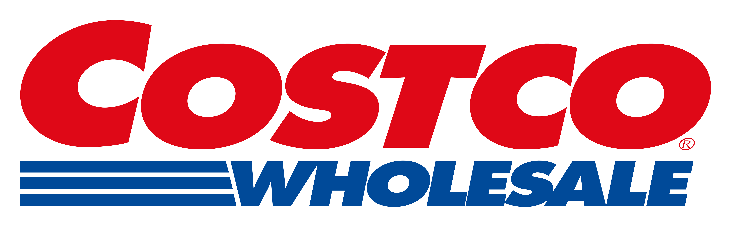
Stock Analysis
2019
2020
NASDAQ: COST
Current stock price: 305.38
Low (52 Weeks): 189.51
High (52 Weeks): 307.34
P/E ratio: 36.93
(After EPS & P/E ratio estimation)
Market Cap: $136.810 Billion
2020 EPS (Est):
Average: 8.24
Low: 7.64
High: 8.76
Average stock price: 304.30
Lowest stock price: 282.15
Highest stock price: 323.51
Selling Costco’s share is recommended. Based on the prediction of 2019 data, 2020 Average stock price will be -0.25%, Lowest will be -7.33% and Highest will be +5.89%. Taking account Inflation & Depreciation, funds would rather be invested in something with much higher ROI.

